Slide 1
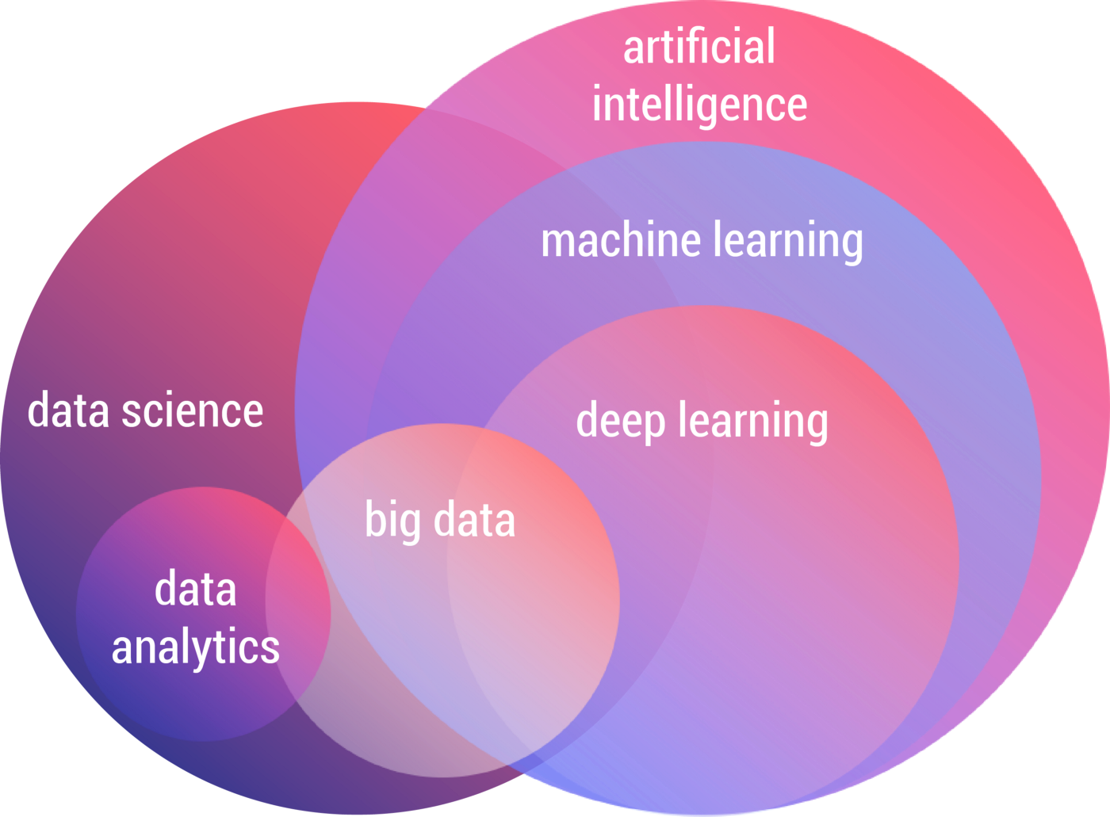
IA & Big Data - Outline
- 2nd part of the option
- Focus on Deep Learning
- Use case on NLP

Slide 2
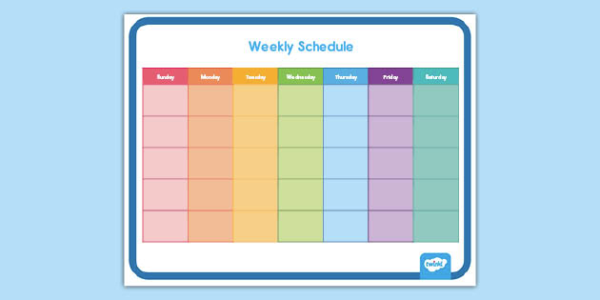
IA & Big Data - Schedule
- Course sessions 4 h
- Theory and Practice
- Lab sessions 4 h
- Small Projects

Slide 3
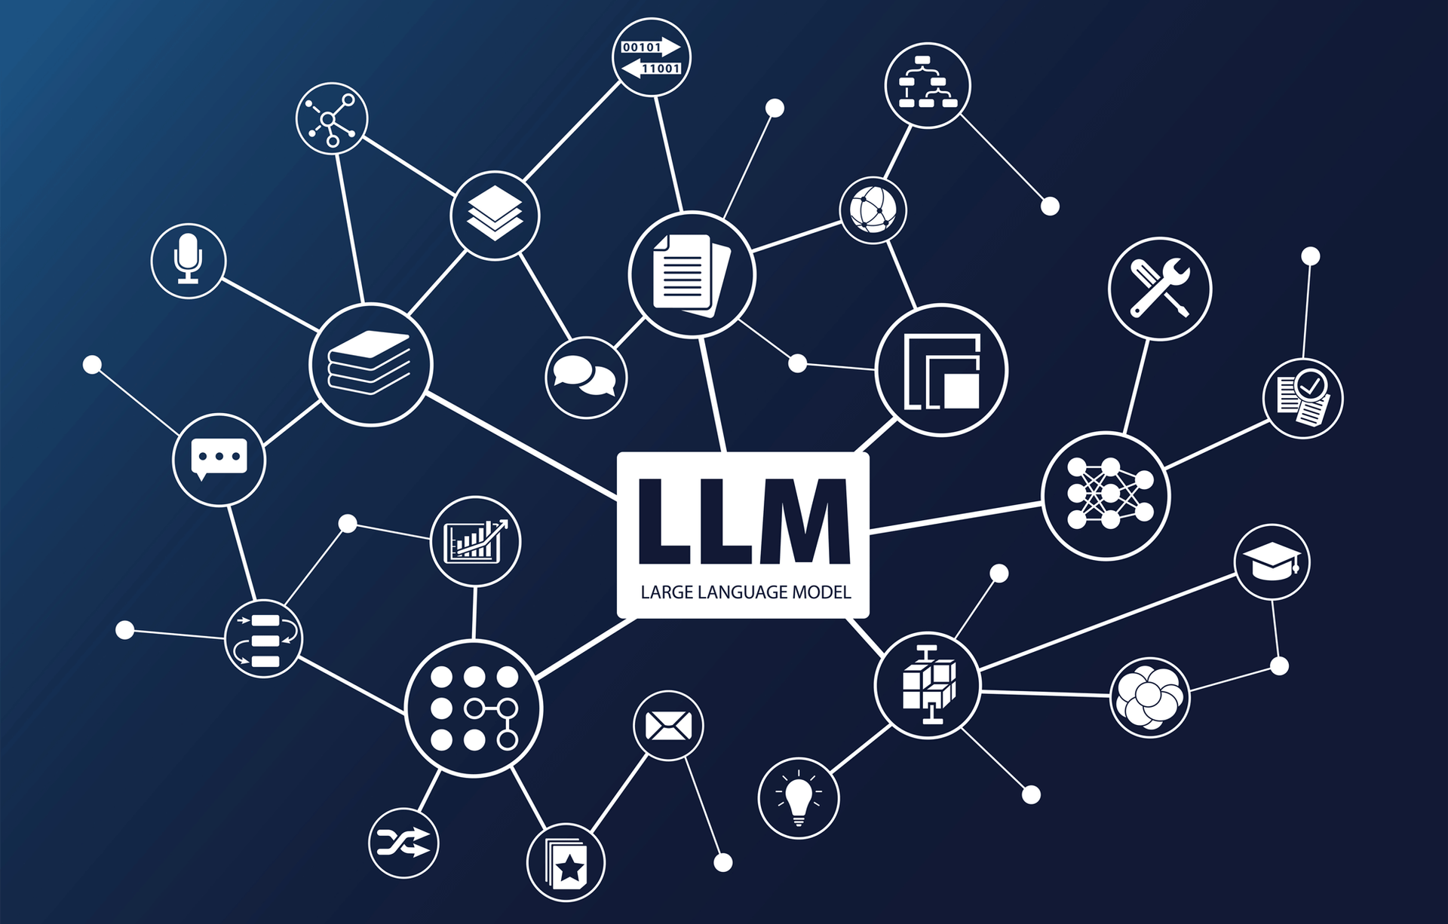
IA & Big Data - Contents
- Deep Learning overview
- Classical NLP
- Fancy LLMs
- LLM Ops x2

Slide 4
DL – Introduction
Introduction to Deep Learning :
Theory and main networks

Slide 5
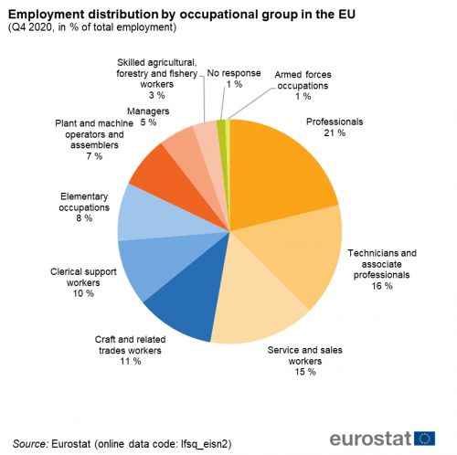
DL – Why Deep Learning ?
« Unleash the unlimited power of data »
What does it mean ?
=> No need for specific knowledge
=> Large variety of applications

Slide 6
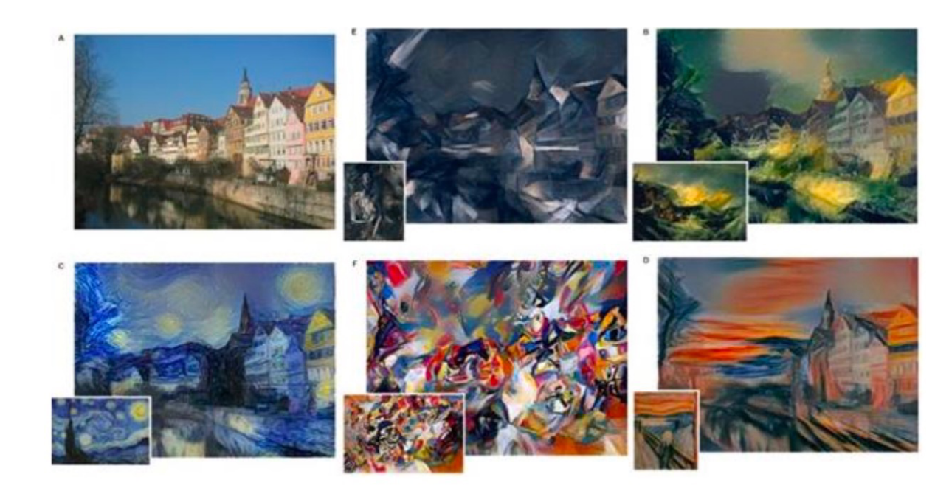
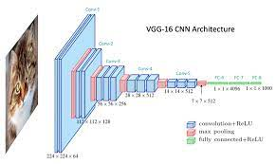
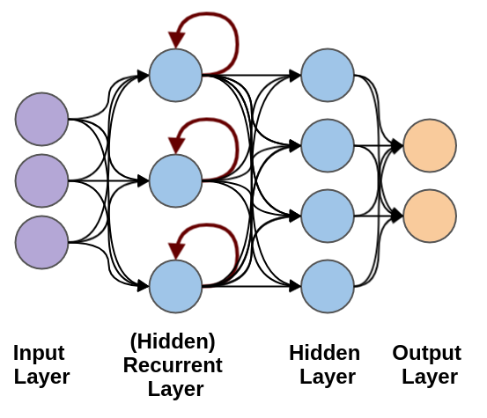
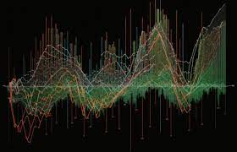
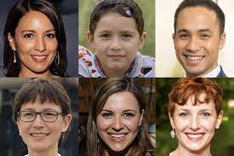
DL – Panorama

Slide 7
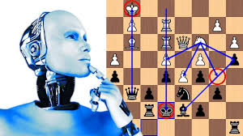
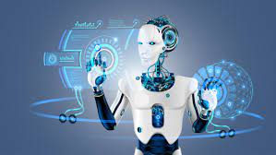

DL – Robotics & Games

Slide 8
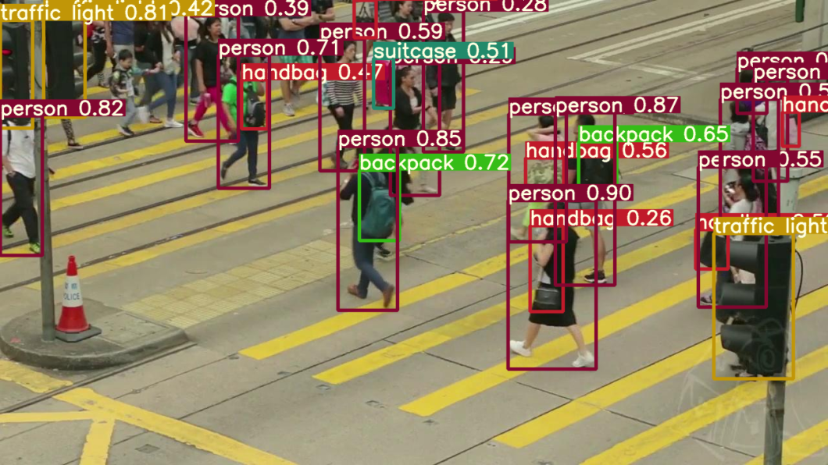
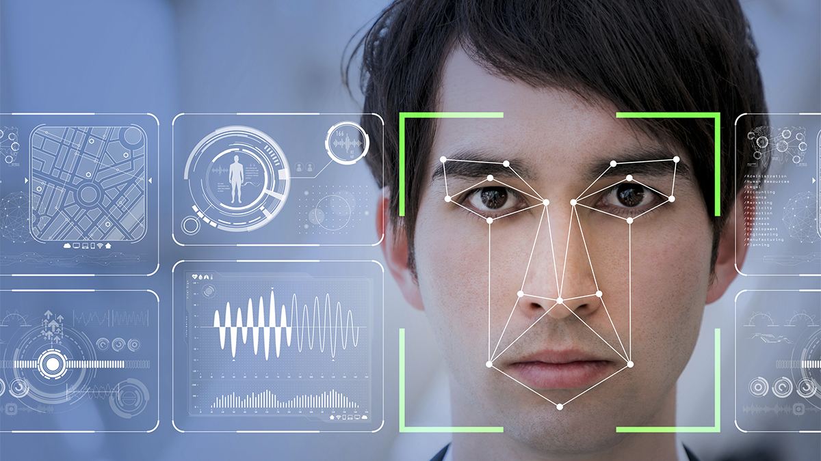
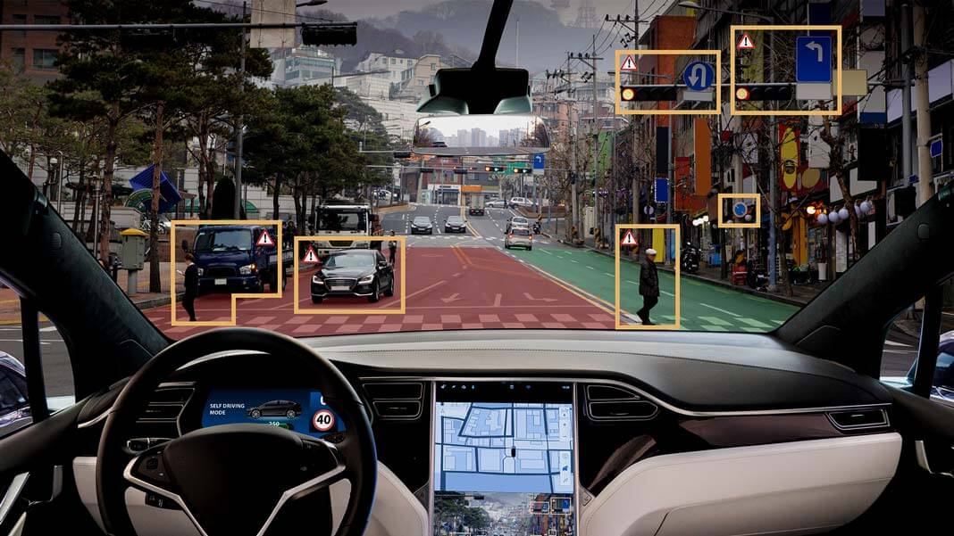
DL – Computer Vision
Object detection
Face recognition
Self-driving cars

Slide 9
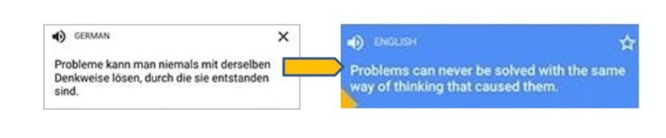
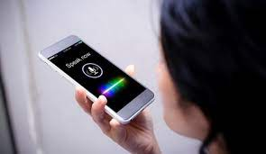

DL – Natural Language
Machine translation
Speech recognition
Sentiment analysis

Slide 10
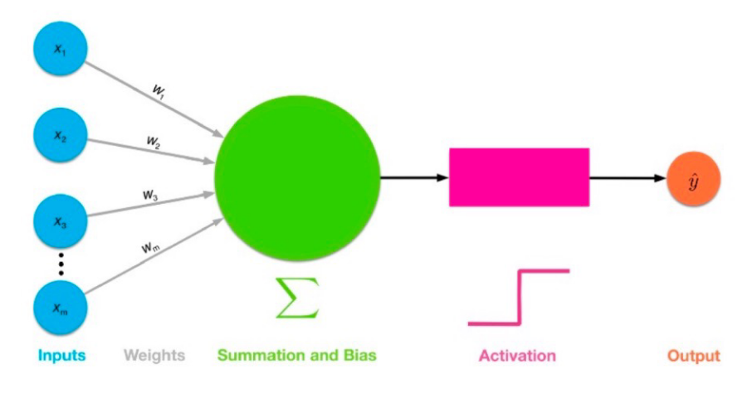
DL – Single Neuron
- Binary Classification
- Logistic regression
-Positive / Negative sentence
Sigmoid
Positive
[0,
1,
2,
3]
[Deep => 0,
Learning => 1,
Is => 2,
Fantastic => 3]
Deep Learning is fantastic

Slide 11
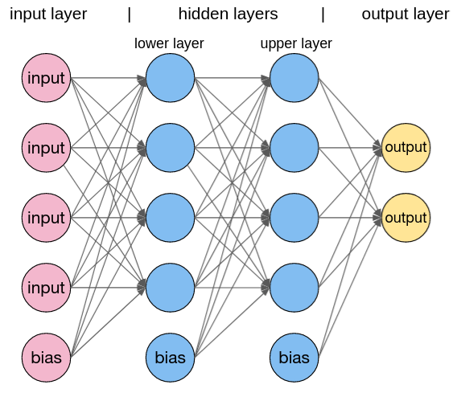
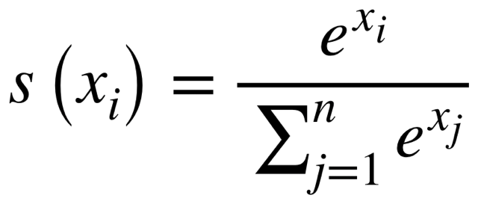
DL – Multi-Layer Perceptron
- Just an extension
- Multi-class Classification
- Softmax regression
- Probabilistic interpretation

Slide 12
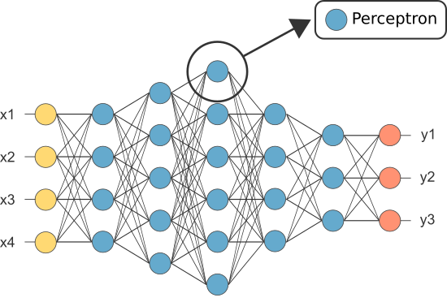
DL – Feed-Forward Neural Network
- Just another extension
- Adding layers => deep
- Various Architectures
How to train the network’s parameters ?

Slide 13
DL – Feed-Forward Neural Network
- Just another extension
- Adding layers => deep
- Various Architectures
How to train the network’s parameters ?
Loss + Gradient Descent

Slide 14
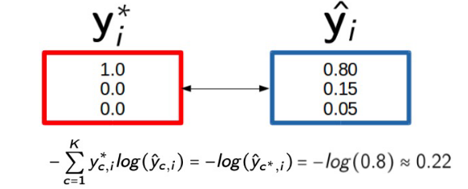
DL – Loss
Loss + Gradient Descent

Slide 15
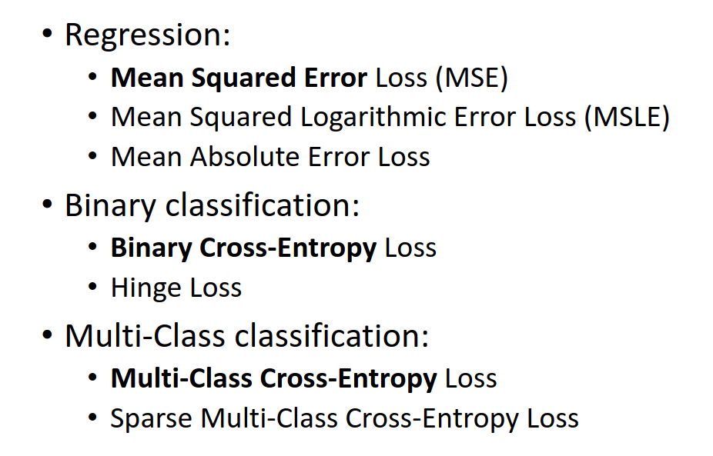
DL – Loss

Slide 16
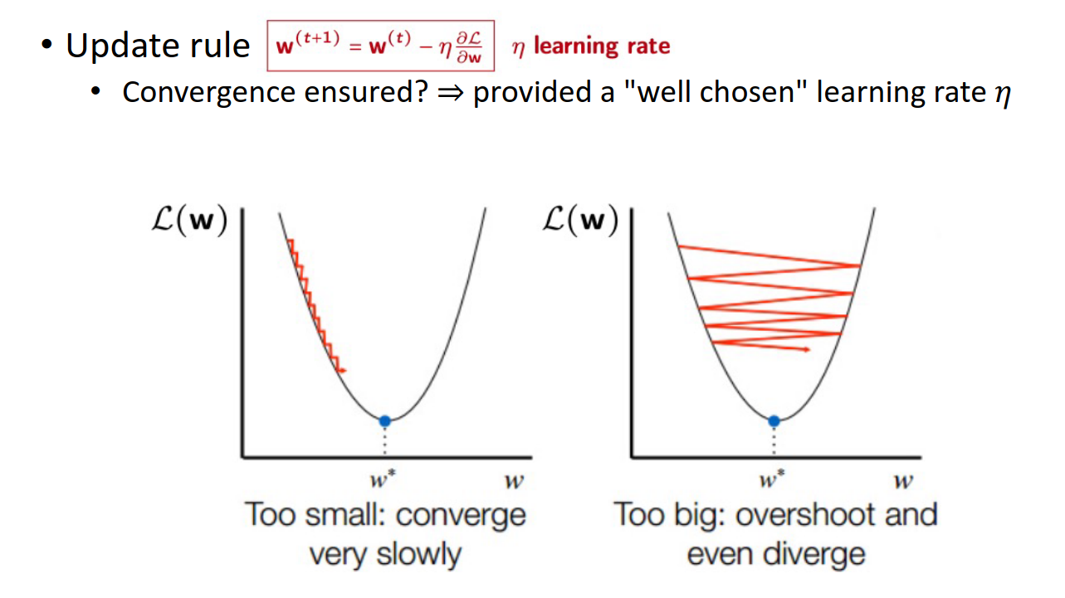
DL – Gradient Descent

Slide 17
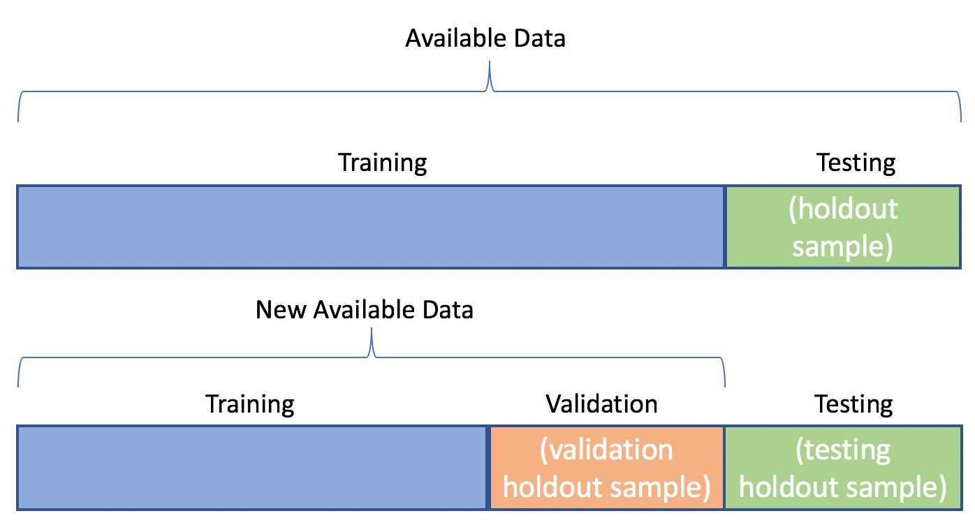
DL – Hyperparameters optimisation

Slide 18
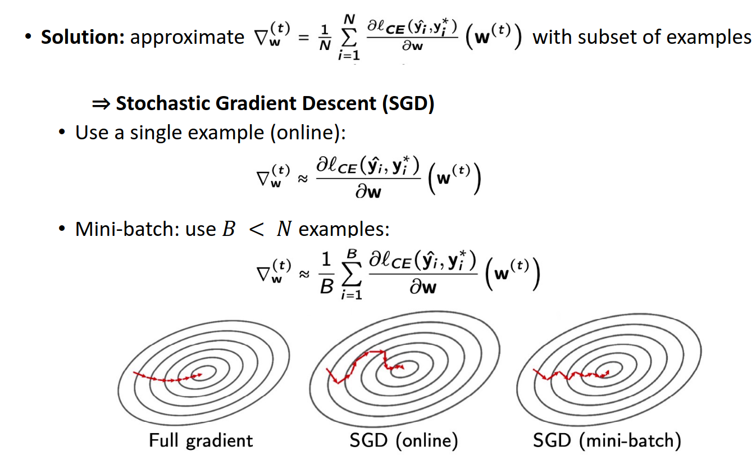
DL – Gradient Descent (variants)

Slide 19
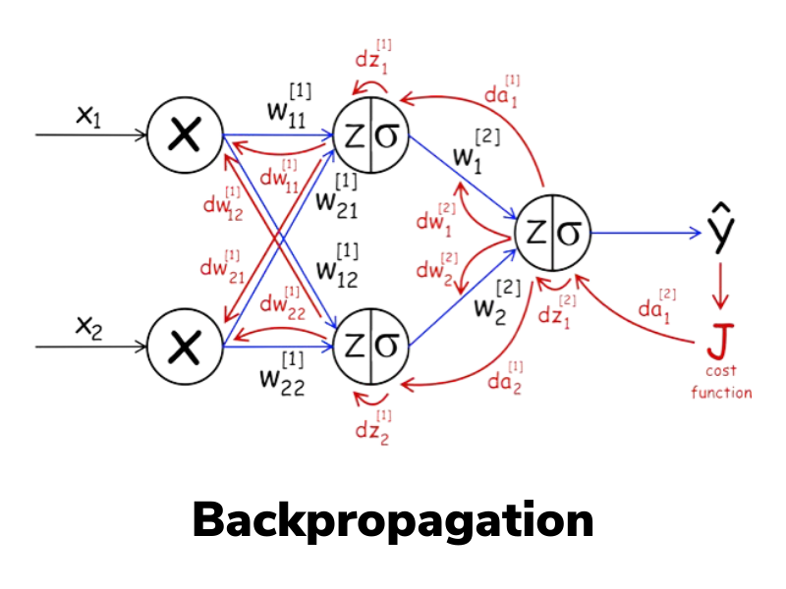
DL – Back(prop) to Single Neuron

Slide 20
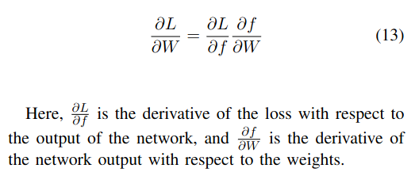
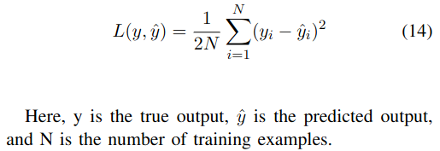
DL – Backpropagation

Slide 21
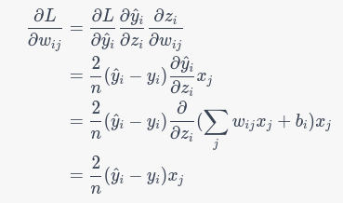
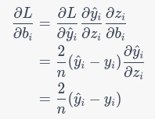
DL – Backpropagation

Slide 22
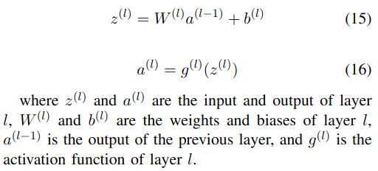
DL – Backpropagation

Slide 23
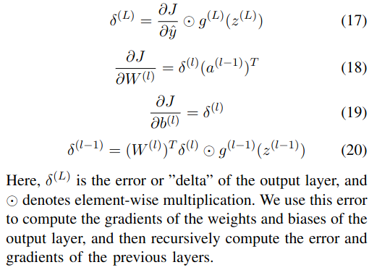
DL – Backpropagation

Slide 24

DL – Gradient Update

Slide 25
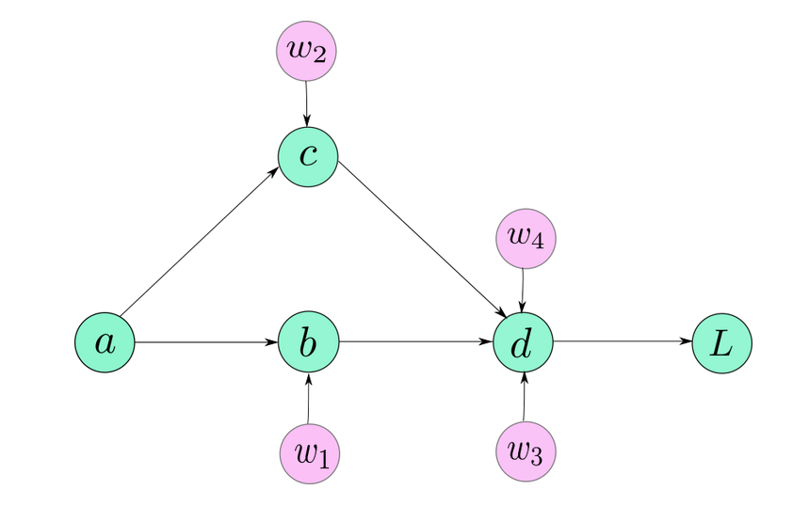
DL – Auto BackProp

Slide 26
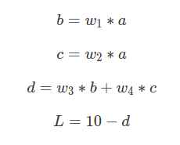
DL – Auto BackProp

Slide 27
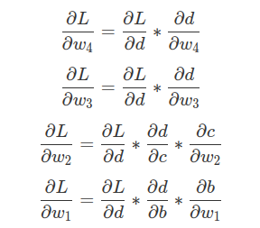
DL – Auto BackProp

Slide 28
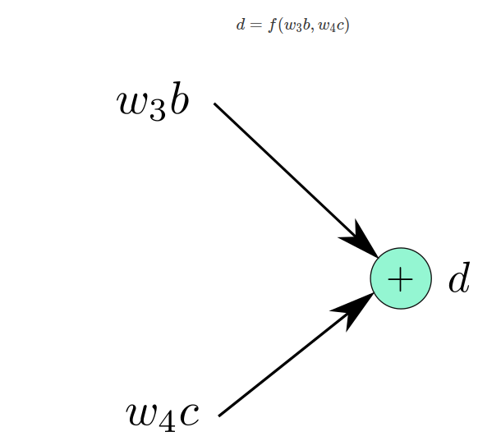
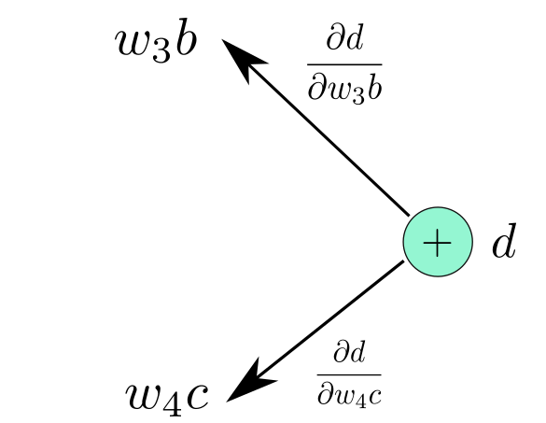
DL – Auto BackProp

Slide 29
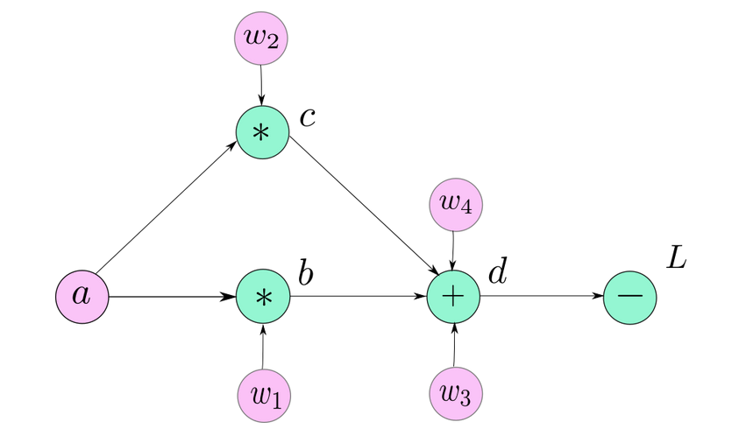
DL – Auto BackProp

Slide 30
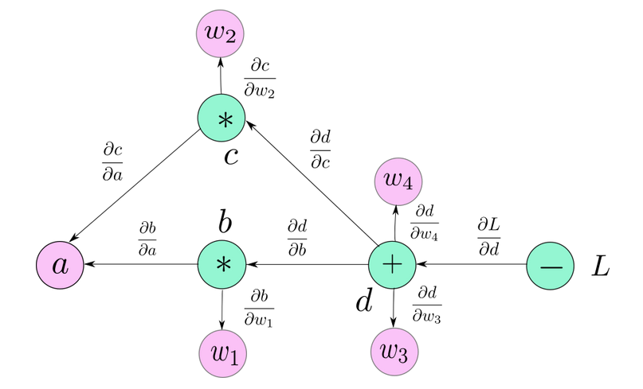
DL – Auto BackProp

Slide 31

DL – Auto BackProp

Slide 32
DL – Backpropagation

Slide 33
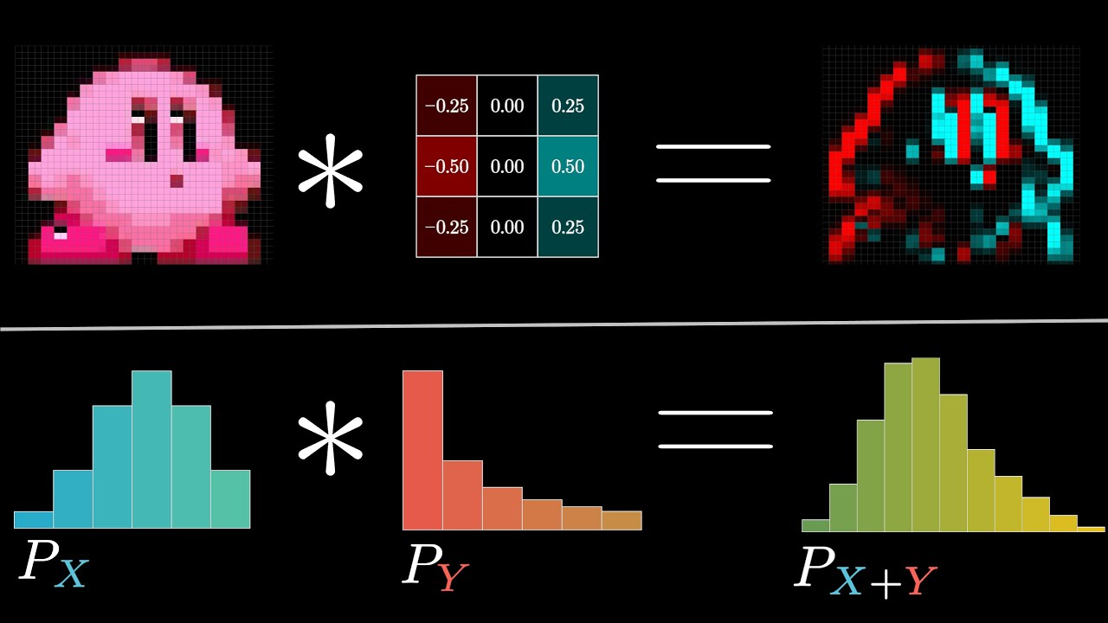
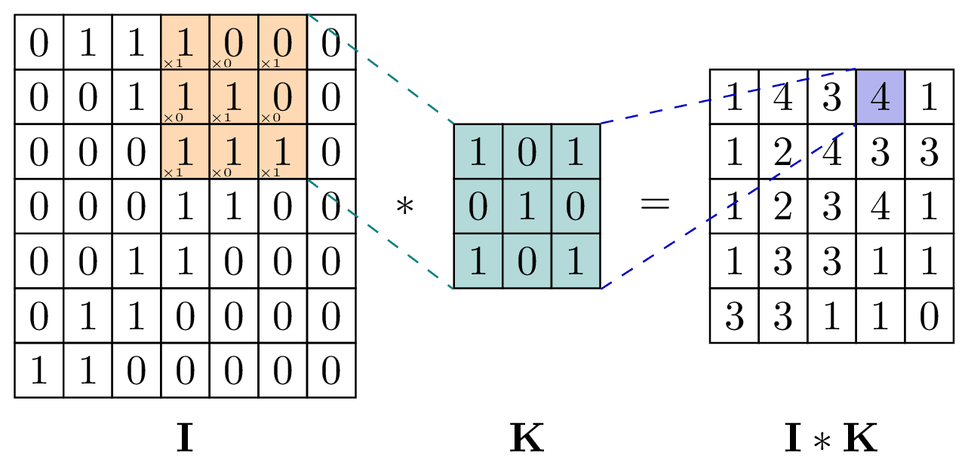
DL – Convolution

Slide 34
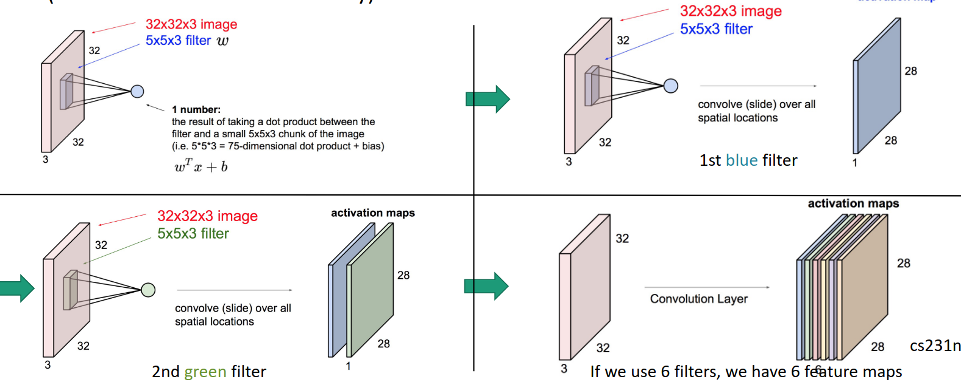
DL – Learned filters and features

Slide 35
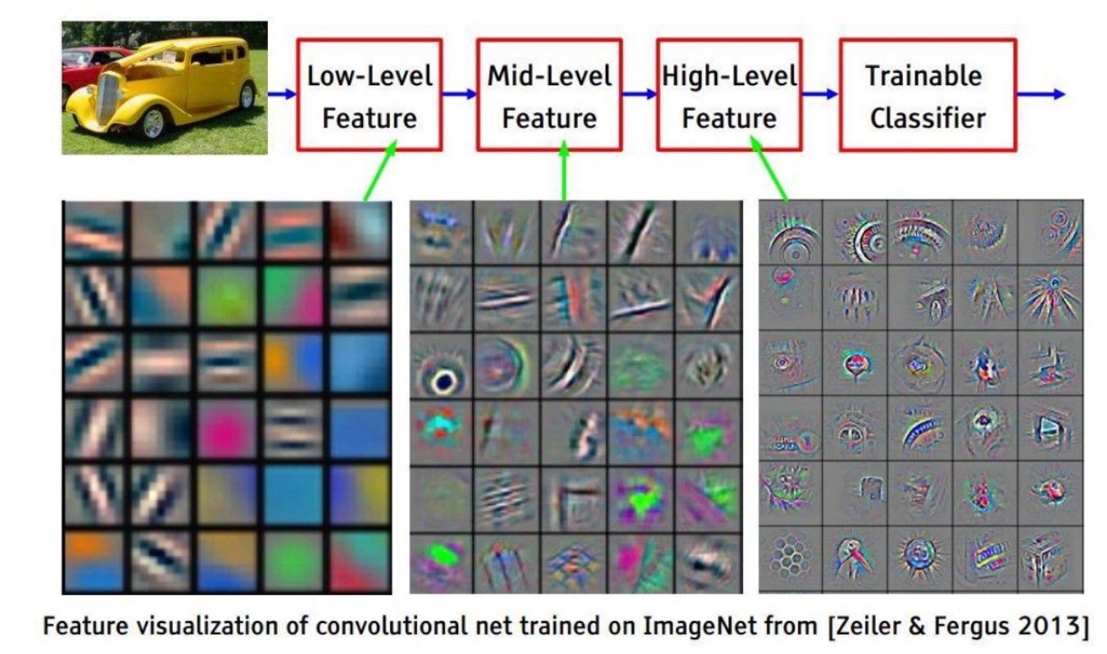
DL – Learned filters and features

Slide 36
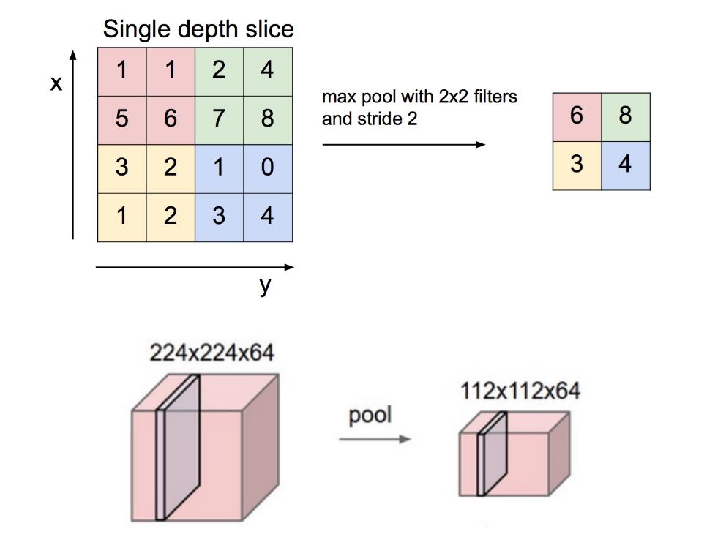
DL – Learned filters and features
- Multiple filters => many computations
- Need for compact representations
- Spatial redundancy

Slide 37
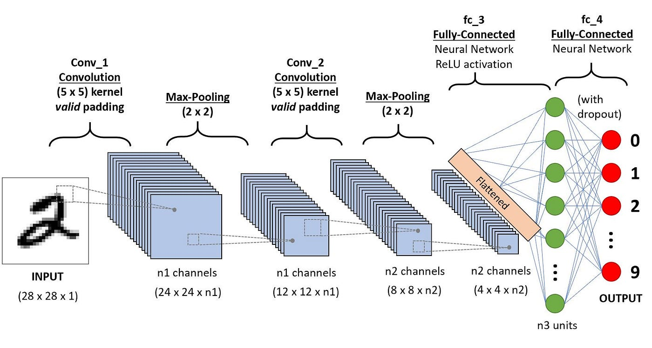
DL – Convolutional Network (CNN)

Slide 38
DL – Convolutional Network (CNN)
- Less connections than FFNN
- Useful for visual data
- Need for regularisations

Slide 39
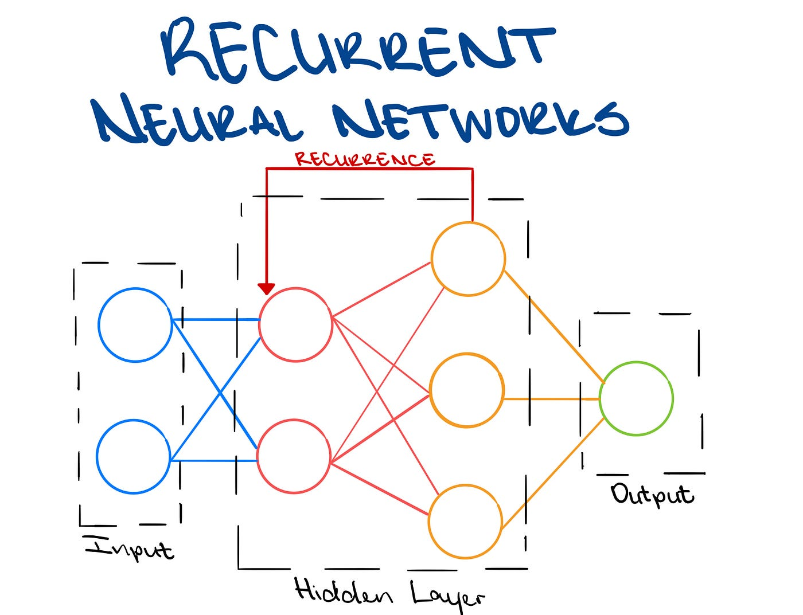
DL - Recurrent Networks (RNN)

Slide 40
DL - Recurrent Networks (RNN)
Sequence friendly
Internal states
Encoding past information

Slide 41
DL - Recurrent Networks (RNN)
Series of ‘cells’
Input + internal state
Output + new internal state

Slide 42
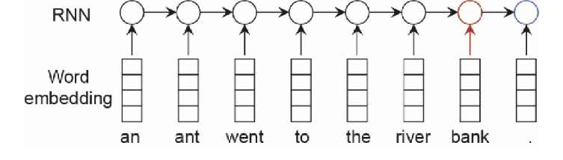
DL - Recurrent Networks (RNN)

Slide 43
DL - RNN training
Harder to train than FFNN
Efficiency limited to length
Gradient vanishing

Slide 44
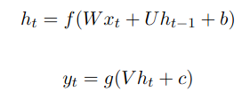
DL - RNN training

Slide 45
DL - RNN gradient vanishing
Eigenvalues dependant
> 1 = exploding
<1 = vanishing

Slide 46
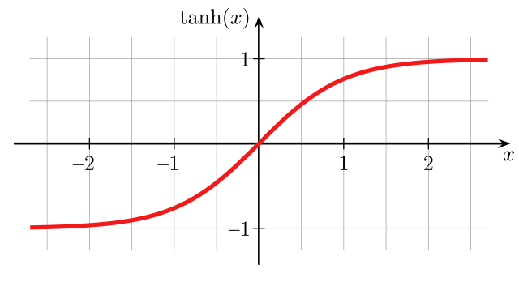
DL - RNN gradient vanishing

Slide 47
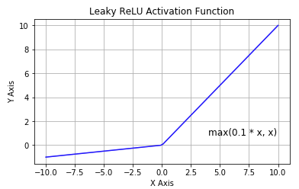
DL - RNN training solutions
Many solutions :
Weights initialization
Gradient clipping
Non-saturating activations

Slide 48

DL - Long Short-Term Memory

Slide 49

DL - LSTM

Slide 50

DL - LSTM

Slide 51
DL - LSTM
Different sets of weights
Decorrelation
Stabilisation of backpropagation

Slide 52

DL - Gated Recurrent Units

Slide 53
DL - GRU
Simpler version of LSTM
Faster to train
Easier to interpret

Slide 54

DL - GRU

Slide 55

DL - RNN, LSTM and GRU

